Slide 1

Connected and Autonomous Robotic System
under the guidance of
Dr. Kaikai Liu
Jay Parsana
Vatsal Makani
Saumil Shah
Prashant Gandhi

Slide 2
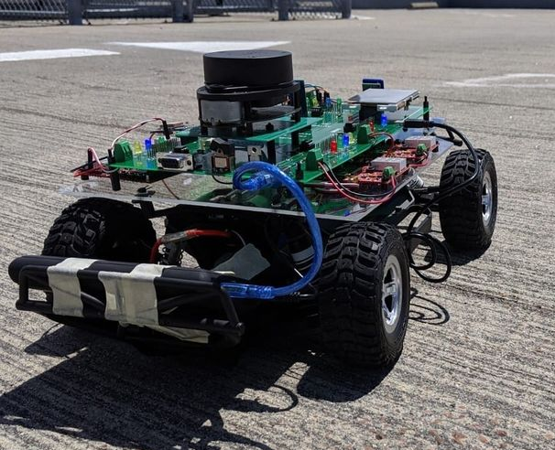
Past Project - Autonomous driving RC car
Overview
Obstacle avoidance using ultrasonic sensors and LIDAR.
Reliable CAN communication between five microcontrollers based on NXP LPC1758.
Functionalities of each controller
Geographical Controller: Path planning using endpoints using GPS and Compass.
Bridge Controller: Rely map coordinates from Android App and Bluetooth.
Master Controller: Manage the flow of data and take control actions.
Motor Controller: Speed control based on RPM sensor feedback and PID Algorithm.
Sensor Controller: Get readings from LIDAR and ultrasonic sensor.
Notes:
Build a Self-Navigating, that navigates from a source location to a selected destination by avoiding obstacles in its path using sensors and motors.

Slide 3
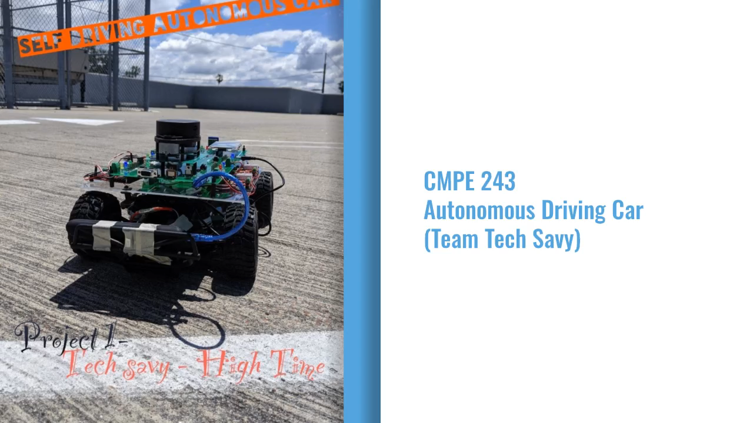
Past Project - Video

Slide 4
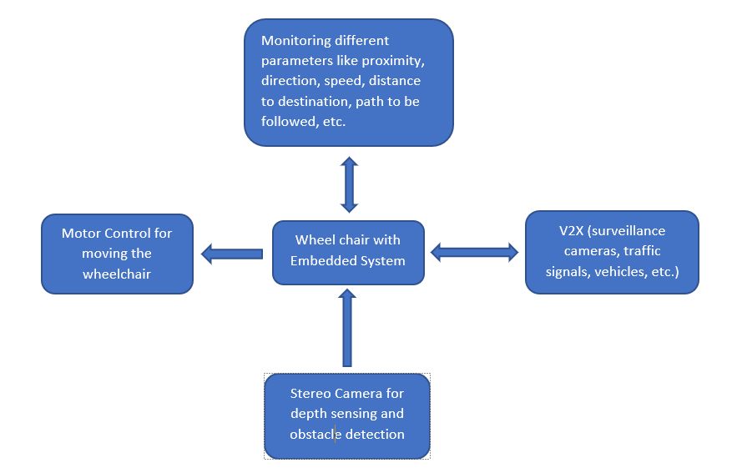
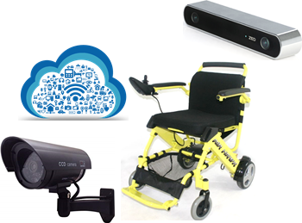
Project Proposal:
Connected and Autonomous Robotic System

Slide 5


